Slide 1

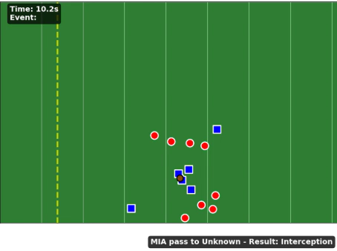
NFL TDA
Applying TDA to quantify defensive coverage gaps and correlation with play outcome
Arjun Mahesh
Notes:
Motivation+Research Question:
Defensive success in football depends on coordinated player spacing.
Can we quantify spatial “coverage gaps” using TDA (persistent homology)?
Goal: Understand how topological features of formations relate to pass outcomes.
In American football, defensive pass coverage creates spatial patterns that determine whether receivers can find open space. Traditional metrics reduce this geometric complexity to scalar quantities such as "yards of separation," losing information about the global structure of defensive formations. This project investigates whether topological data analysis, specifically persistent homology, can capture richer structural information about coverage patterns and whether such topological features correlate with play outcomes.The central research question is: \textbf{Can persistent homology quantify defensive coverage gaps, and do such topological features correlate with pass completion?}
TDA has been successfully applied to sports analytics in prior work. Pierson et al. used persistent homology on NBA roster Data to identify topological signatures correlated with offensive performance \cite{pierson2019}. In soccer, TDA-based methods have captured nonlinear relationships in player positioning that traditional clustering misses \cite{wu2022}. Our work extends this methodology to NFL defensive formations, where the geometric interpretation of $H_1$ as "holes" directly corresponds to open passing lanes.The contributions of this project include: (1) a complete pipeline for computing persistent homology from NFL tracking data, (2) statistical analysis relating topological features to pass outcomes, (3) temporal extension tracking topology evolution during plays, and (4) unsupervised coverage type classification using $H_1$ signatures.
Persistence Diagrams
Landscapes/Images
Betti Curves
Bottleneck/Wasserstein
Permutation Tests
Mapper
Clustering/MDS
Temporal H1
Disguise Metric
Betti Surfaces

Slide 2
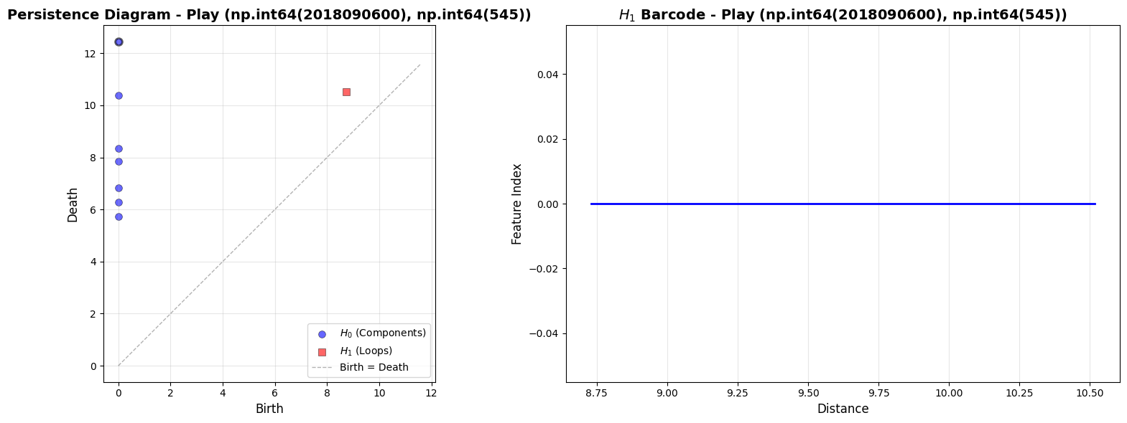

Persistence Diagrams
Data: NFL Big Data Bowl 2021, 253 games, 19237 plays
Each frame → players’ XY positions → distance-based Vietoris-Rips complex
H₀ (components): tightness or dispersion of defenders
H₁ (holes): coverage gaps that a QB might exploit
Persistence diagrams summarize topology at different distance scales
$$Diagram:D=\left\{\left(b_{1}, d_{1}\right)\right\}$$
$${\begin{aligned} \\ β\end{aligned}}_{p}=\# features in H_{p}$$
Notes:
253 games, 19,237 passing plays, 986,022 total tracking frames
For static analysis, we extract defender positions at the moment of pass release (identified by the \texttt{pass\_forward} event), yielding 17,740 usable plays after filtering for data quality. The average number of defenders per play is 7.7, with range 4--11. For temporal analysis, we extract formations at 9 time points per play from snap to pass outcome, covering 962 plays with complete temporal data.
The blue dots (H₀) show 6 defenders merging into 1 component as scale increases. The red square (H₁) shows one coverage gap born at ~8.7 yards, dying at ~10.5 yards — a 1.8-yard persistent hole. The barcode visualizes this H₁ feature's lifespan.

Slide 3
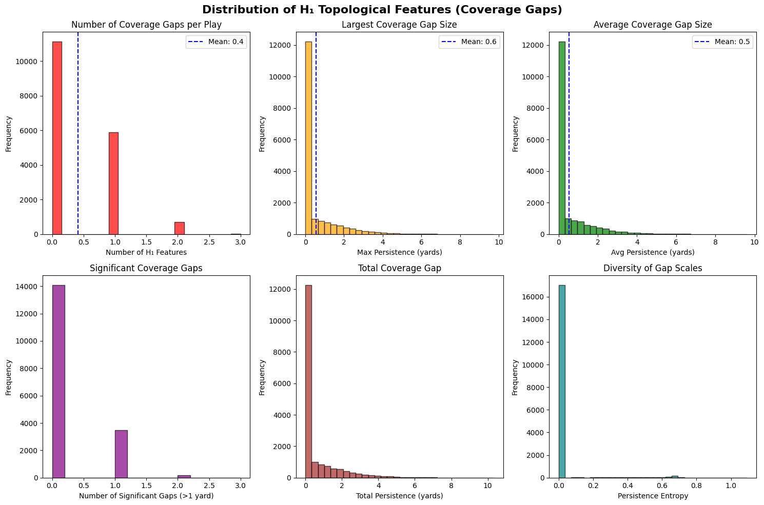
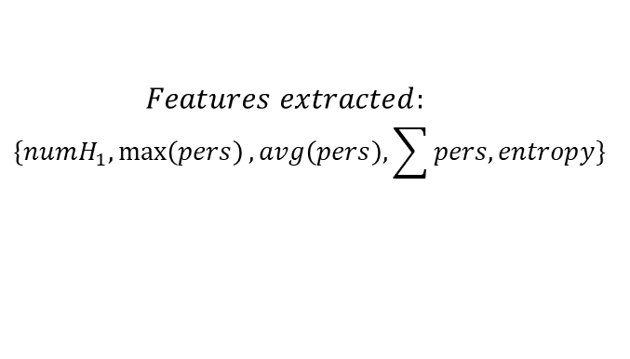
Feature Extraction & Distribution
Most plays have 0–1 loops (coverage gaps)
  Mean H₁ features per play: 0.41
Gaps vary in size (persistence), there are few large gaps
Persistence entropy is low → gaps tend to occur on consistent scales.
  Mean max persistence: 0.6 yds
$$Features extracted:$$
$$\{numH_{1},\max\left(pers\right), avg\left(pers\right), \sum{pers, entropy}\}$$
Notes:
After computing persistence for all the plays, we extract summary statistics. The distributions show most plays have tight coverage (0 gaps), but a meaningful subset shows persistent holes. This motivates asking: do these gaps correlate with completion?

Slide 4
H₁ features correlate with pass completion
Feature | Complete | Incomplete | t-stat | p-value
H₁ max persistence | 0.533 | 0.581 | -2.80 | 0.005
H₁ avg persistence | 0.512 | 0.554 | -2.57 | 0.010
Incomplete passes show larger H₁ gaps (counterintuitive)
> “Bait” zones deliberately created by defenses?
Notes:
Statistically significant difference in max H₁ persistence (p=0.005).
This suggests coverage gaps at the moment of pass aren't simply "open = completion." Defenses may intentionally create deceptive openings, or quarterbacks misread coverage depth. The box plots show substantial overlap but the tails differ.

Slide 5
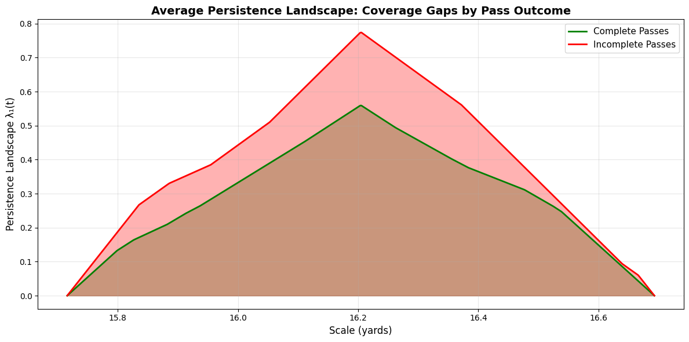
Vectorization – Persistence Landscapes
$$λ_{k}\left(t\right)=kth largest value of {min⁡(t −b_{i}, d_{i}−t)}^{+}$$
Landscapes live in a Banach space
  Can compute means, variances
Complete passes show lower landscape values than incomplete
Peak difference occurs around 16.2-yard scale
Scale corresponds to typical intermediate route depth
Notes:
Persistence landscapes convert diagrams into functional summaries we can average and compare statistically. The mean landscape for incomplete passes dominates complete passes — again showing larger topological features in failed plays. The peak around 16 yards suggests this is a critical scale for defensive holes.

Slide 6
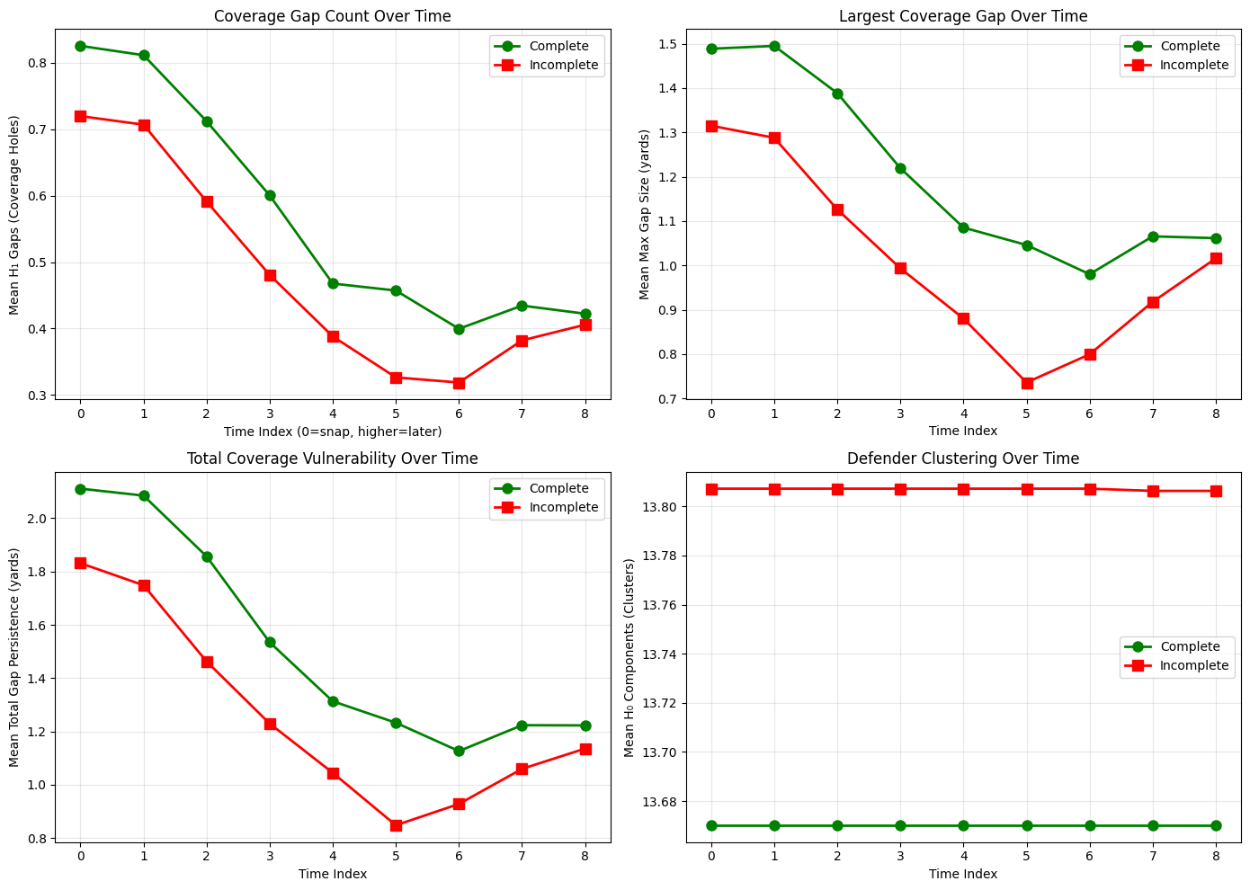
Temporal TDA: Coverage evolving during play
H₁ gaps decrease from snap to pass
  0.83 → 0.40 for completions
Complete passes maintain larger gaps throughout
H₁ components stable (13.7), clustering structure preserved
Gap probability:
  Complete: 44% → 27% at pass
  Incomplete: 38% → 19% at pass
Defenses close gaps as plays develop
Successful passes exploit early-forming holes
Notes:
we tracked topology across 962 plays at 9 time points each. Coverage gaps are largest at the snap and shrink as defenders react. Critically, complete passes show consistently higher H₁ features throughout — suggesting successful quarterbacks target gaps that form early and persist. The H₀ stability indicates defenders maintain relative positioning even as gaps close.

Slide 7
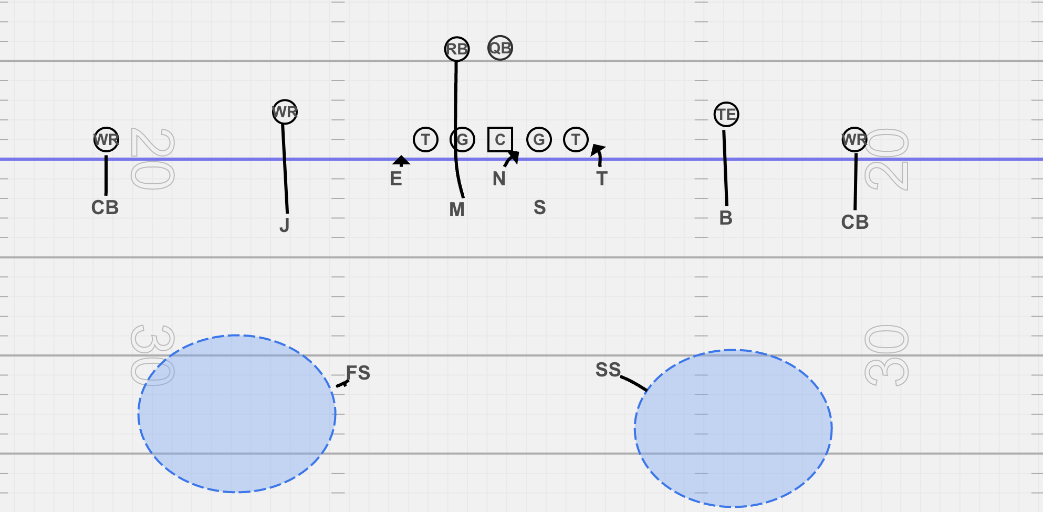
Man
Zone

Slide 8
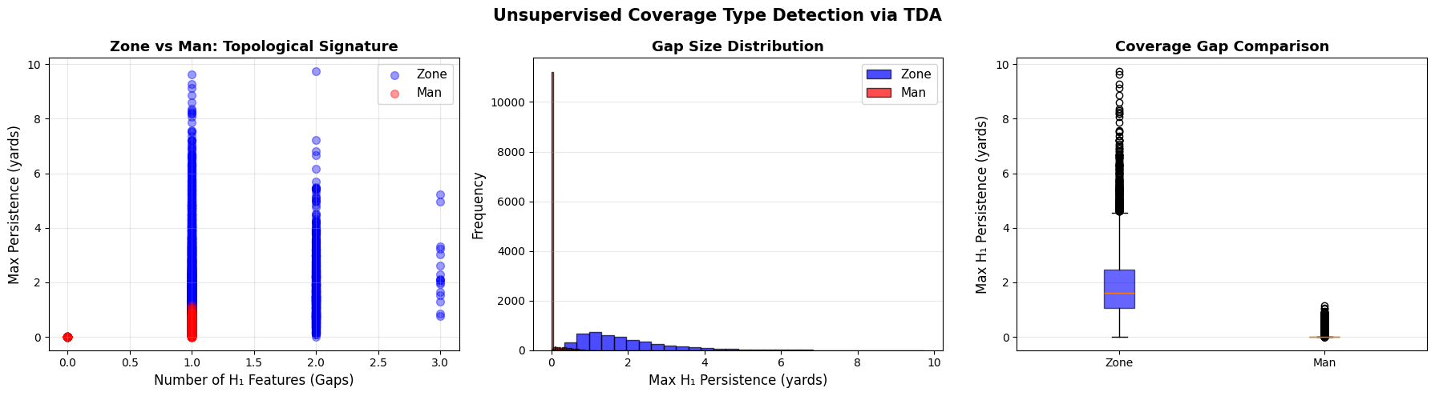
Zone v. Man Coverage
ZONE Coverage: 4695 plays (26.5%)
H₁ features | 1.156 gaps/play
Max persistence | 1.941 yards
Avg persistence | 1.853 yards
Defenders in box | 5.9
MAN Coverage: 12990 plays (73.5%)
H₁ features | 0.146 gaps/play
Max persistence | 0.048 yards
Avg persistence | 0.048 yards
Defenders in box | 6.1
Zone shows 40.8x larger H₁ gaps than Man
Notes:
Without any coverage labels, clustering on H₁ features alone recovers zone vs man distinction — zone defenses create territorial gaps by design, man coverage stays tight to receivers.

Slide 9
Conclusion
TDA successfully quantifies coverage structure
  H₁ persistence captures "holes" in defensive formations
Significant statistical relationship
  H₁ features differ between complete/incomplete (p < 0.01)
Counter-intuitive direction
  Larger gaps correlate with incompletions (defensive deception?)
Temporal dynamics matter
  Gaps close over time; completions exploit early openings
Classify zone vs. man coverage
Notes:
Persistence Diagrams: “What gaps exist in this formation?”
Landscapes/Images: “How do I average/vectorize diagrams for stats/ML?”
Betti Curves: “At what scale do gaps appear?”
Bottleneck/Wasserstein: “How similar are two formations topologically?”
Permutation Tests: “Is the difference statistically significant?”
Mapper: “What is the global shape of formation space?”
Clustering/MDS: “Are there natural formation types? Can I visualize?”
Temporal H1: “How do gaps evolve during a play?”
Disguise Metric: “Did the defense change structure mid-play?”
Betti Surfaces: “where and when are defenses most vulnerable?”
Static TDA Techniques
1. Persistence Landscapes
Purpose: Enable statistical comparison between groups
Why you computed it: Raw persistence diagrams can't be averaged (they're multisets of varying cardinality). Landscapes map diagrams to a Banach space where you can compute means, variances, and confidence bands. This lets you ask: "Is the average topological signature of complete passes different from incomplete passes?" Your landscape plot (Image 4) showed incomplete passes have higher mean λ₁(t), quantifying the group difference functionally.
2. Persistence Images
Purpose: Fixed-dimensional vectorization for ML pipelines
Why you computed it: If you wanted to feed topological features into a classifier (e.g., logistic regression predicting completion), you need fixed-size vectors. Persistence images discretize the birth-death plane into a grid, weight by persistence, and smooth with a Gaussian. Your 3-panel image (Large Gap / Small Gap / No Gaps) shows how different coverage patterns produce visually distinct "fingerprints." This enables downstream classification or clustering with standard ML tools.
3. Betti Curves
Purpose: Track feature counts across all filtration scales
Why you computed it: β₀(ε) tells you "how many defender clusters exist at scale ε" and β₁(ε) tells you "how many coverage holes exist at scale ε." Your Betti curve plot (Image 6) shows β₀ starting at 6 (isolated defenders) and decreasing as clusters merge, while β₁ = 1 for ε ∈ [8.75, 10.5] yards — precisely localizing where the coverage gap lives in scale-space. This gives interpretable, scale-specific information beyond summary statistics.
4. Bottleneck Distance
Purpose: Principled metric on persistence diagrams with stability guarantees
Why you computed it: To compare individual formations, you need a distance function. Bottleneck distance satisfies the stability theorem: if point clouds are perturbed by at most δ, their diagrams move by at most δ in bottleneck distance. This means your comparisons are robust to noise (player tracking error, slight positional shifts). Your distance matrix (Image 7) uses this to find which plays have similar/different topological structure.
$$d_{B}\left(D_{1} , D_{2}\right)=\underset{γ}{\inf{}}\underset{x}{\sup{}}∥x−γ\left(x\right)∥_{∞}$$
5. Wasserstein Distance
Purpose: More discriminative alternative to bottleneck
Why you computed it: Bottleneck only considers the single worst-matched point. Wasserstein (p=1 or p=2) considers all points, making it more sensitive to global differences. Your comparison showed Wasserstein ≥ Bottleneck in all cases. For clustering formations into types, Wasserstein may separate similar-looking diagrams that bottleneck considers identical.
$$W_{p}\left(D_{1} , D_{2}\right)={\left(\underset{γ}{\inf{}}\sum_{x}{∥}x−γ\left(x\right)∥^{p}\right)}^{1/p}$$
6. Permutation Tests
Purpose: Statistical inference without distributional assumptions
Why you computed it: To formally test "do complete and incomplete passes have different topological signatures?" you need hypothesis testing. But persistence diagrams don't follow known distributions. Permutation tests shuffle outcome labels and recompute test statistics to build an empirical null distribution. Your result (p = 0.27) suggested no significant difference in diagram-level tests, while feature-level t-tests (p = 0.005) found significance — highlighting that how you summarize diagrams matters.
7. Mapper Algorithm
Purpose: Visualize high-dimensional data structure as a graph
Why you computed it: Mapper approximates the Reeb graph — it shows how your formation space is "shaped" by clustering at overlapping intervals of a filter function. You hoped to find distinct nodes corresponding to different coverage types (zone vs man, blitz vs coverage). Your result (1 node, 0 edges) suggests the formations are topologically homogeneous at the parameters chosen, or the filter function wasn't discriminative enough. This is a null result but still informative.
8. Hierarchical Clustering
Purpose: Find natural groupings of formations by topological similarity
Why you computed it: Using bottleneck distances as input to hierarchical clustering reveals whether distinct "types" of defensive formations exist. Your dendrogram (Image 9) shows most formations cluster tightly (low merge heights) with a few outliers merging at 2-4 yards. This suggests a continuum of coverage structures rather than discrete archetypes — or that H₁ alone doesn't separate zone/man cleanly (until you did the explicit clustering in your Zone vs Man analysis).
9. MDS Visualization
Purpose: 2D embedding preserving pairwise topological distances
Why you computed it: To see the formation space. MDS projects the 100×100 bottleneck distance matrix into 2D while preserving distances as well as possible (stress = 39.24). Your plot (Image 10) shows partial separation of complete (green) vs incomplete (red) passes, with outliers representing topologically unusual formations. This gives geometric intuition about where different outcomes live in "topology space."
Temporal Analysis
10. Gap Evolution (H₁ over time)
Purpose: Capture how coverage structure changes during a play
Why you computed it: Static analysis only looks at one frame (ball release). But coverage gaps evolve — they may not exist at the snap but open as defenders react to routes. Your finding that H₁ decreases from snap to pass (0.83 → 0.40) shows defenses actively close holes. Complete passes maintaining larger gaps throughout suggests QBs exploit gaps that persist under defensive pressure.
11. Disguise Metric (Bottleneck snap→pass)
Purpose: Quantify how much topology changes during a play
Why you computed it: If a defense "disguises" coverage (shows zone, rotates to man), the topological structure should change significantly. You defined:
$$\text{Disguise}=d_{B}\left(D_{\text{snap}} , D_{\text{pass}}\right)$$
Your finding that incomplete passes have higher disguise (5.44 vs 4.58, p < 0.001) suggests defensive deception correlates with stopping passes — the coverage the QB read pre-snap wasn't what he faced at release.
12. Time-to-Gap
Purpose: Identify when coverage breaks down
Why you computed it: For play design, knowing that gaps form immediately (completions: median 0.0s) vs delayed (incompletions: median 0.4s) has tactical implications. Quick-forming gaps favor timing routes; late gaps require longer-developing plays. This connects topology to football strategy.
13. Betti Surfaces β₁(scale, time)
Purpose: Joint distribution of gaps across scale AND time
Why you computed it: This is your most sophisticated temporal analysis. The heatmap shows gaps emerge most at ~9-11 yards, around 0.8-1.6s post-snap. The difference plot (complete - incomplete) reveals exactly where in (scale, time) space completions differ — giving coaches actionable insight about which routes at which depths exploit coverage vulnerabilities.

